Slide 1
CMPT353 Project Coffee shop
Yuwen Liu
Yul905
11219371

Slide 2
Part A
Front-end
User
Login --> POST user/login
Logout --> remove user login info
Register (customer) --> POST user/register
Menu
List of menus --> GET menu
Add/modify menu item (staff) --> POST menu or PUT menu?id=something
Submit --> PUT order?id=something
Order
List of order history order by time ->GET order?userId=#&submitted=true
Cancel order à PUT order?Id=#&cancelled
List of open orders sorted by timeàGET order?submitted=true&ready=false
Modify ready state àPUT order?id=#

Slide 3
Back-end
User
POST user/login by --> body: username & password --> the user object
POST user/register --> body: username & password -> true | false
Now: 3 input username password role can be changed to 4input
Menu
GET menu/
?id
Take one or all menu
POST menu/ --> body: menu detail
Add new menu
PUT ?menu/?id --> body: menu detail
Changed menu(found by id ) detail
Order
GET order
?userId
?submitted
?ready
Return order item by userId
POST order --> body: info of the order (user id, menu items, etc.)
Add item into order
PUT order?id -> body: info of the order (maybe just ready state or submitted state or cancelled)

Slide 4
Database
User
Id
Username
Password
Name
Role: ‘customer’ | ‘staff’
Menu
Id
Name
Unit Price
Order
Id
userId
time
Ready
Cancelled
content

Slide 5
Ionic
UI Component
Adaptive Styling
Navigation
Native Access
Theming

Slide 6
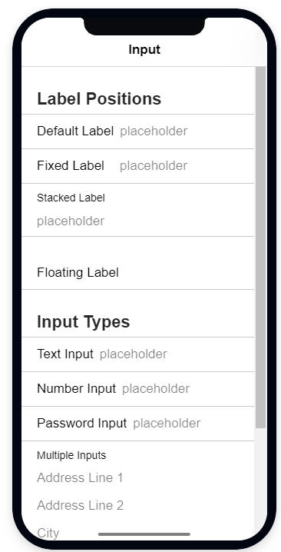
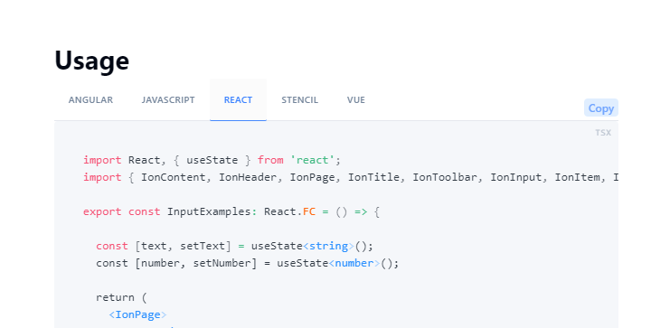

Slide 7
New technology is fast

